Slide 1

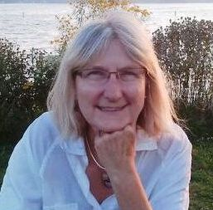

You are Becoming More YOU than you’ve ever been…
CHANGING is Spiritual…
deeply Personal … Self-Refining …
Your Life … Your JOY … Your Time …
Schedule a FREE 30-minute Discovery Session
WonderSpirit Coaching
feminine spirit art & soul-centered
Anne Wondra , Owner-founder coach writer
WonderSpirit.com | 262-544-4310

